Slide 1
Universality Class
SungBin LEE
Dept. of Physics and Astronomy
Seoul National University

Slide 2
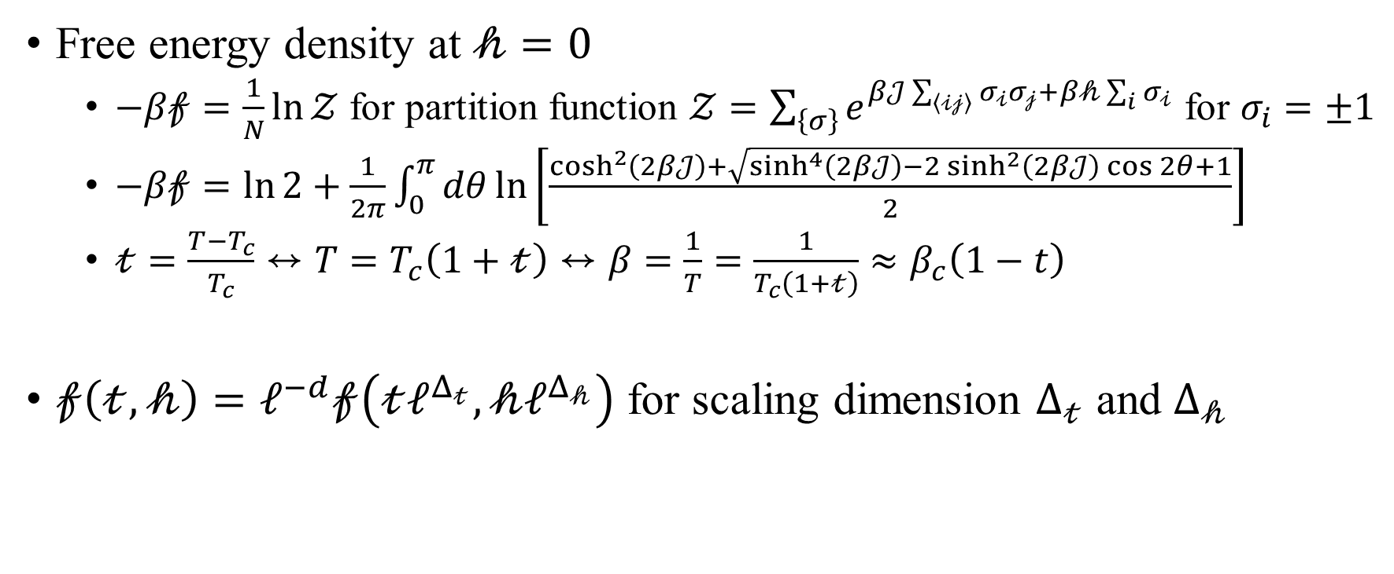
2D Ising model on square lattice
Free energy density at $𝒽=0$
$−β𝒻=\frac{1}{N}\ln{𝒵}$ for partition function $𝒵=\sum_{\left\{σ\right\}}{e^{β𝒥\sum_{\left\langle 𝒾𝒿\right\rangle }{σ_{𝒾}σ_{𝒿}}+β𝒽\sum_{i}{σ_{𝒾}}}}$ for $σ_{i}=±1$
$−β𝒻=\ln{2}+\frac{1}{2π}\int_{0}^{π}{dθ\ln\left[\frac{\cosh^{2}\left(2β𝒥\right)+\sqrt{\sinh^{4}\left(2β𝒥\right)−2\sinh^{2}\left(2β𝒥\right)\cos{2θ}+1}}{2}\right]}$
$𝓉=\frac{T−T_{c}}{T_{c}}↔T=T_{c}\left(1+𝓉\right)↔β=\frac{1}{T}=\frac{1}{T_{c}\left(1+𝓉\right)}≈β_{c}\left(1−t\right)$
$𝒻\left(𝓉,𝒽\right)=ℓ^{−d}𝒻\left(𝓉ℓ^{Δ_{𝓉}},𝒽ℓ^{Δ_{𝒽}}\right)$ for scaling dimension $Δ_{𝓉}$ and $Δ_{𝒽}$

Slide 3
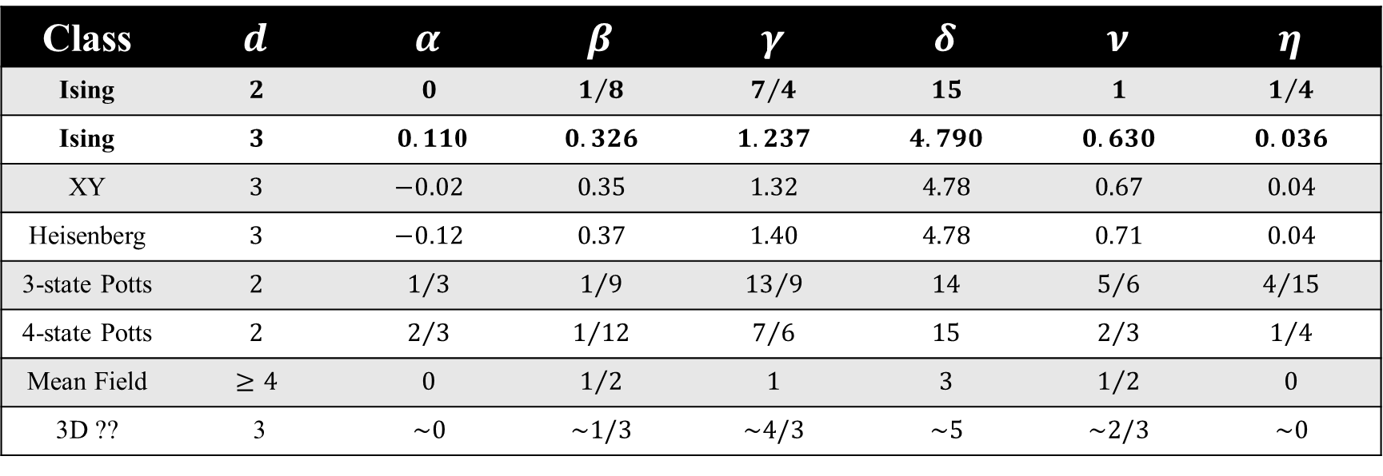
Critical Exponents
Class | $$d$$ | $$α$$ | $$β$$ | $$γ$$ | $$δ$$ | $$ν$$ | $$η$$
Ising | $$2$$ | $$0$$ | $$1/8$$ | $$7/4$$ | $$15$$ | $$1$$ | $$1/4$$
Ising | $$3$$ | $0.11$0 | $$0.326$$ | $$1.237$$ | $$4.790$$ | $$0.630$$ | $$0.036$$
XY | $$3$$ | $$−0.02$$ | $$0.35$$ | $$1.32$$ | $$4.78$$ | $$0.67$$ | $$0.04$$
Heisenberg | $$3$$ | $$−0.12$$ | $$0.37$$ | $$1.40$$ | $$4.78$$ | $$0.71$$ | $$0.04$$
3-state Potts | $$2$$ | $$1/3$$ | $$1/9$$ | $${13}/9$$ | $$14$$ | $$5/6$$ | $$4/{15}$$
4-state Potts | $$2$$ | $$2/3$$ | $$1/{12}$$ | $$7/6$$ | $$15$$ | $$2/3$$ | $$1/4$$
Mean Field | $$≥4$$ | $$0$$ | $$1/2$$ | $$1$$ | $$3$$ | $$1/2$$ | $$0$$
3D ?? | 3 | $$\sim 0$$ | $$\sim 1/3$$ | $$\sim 4/3$$ | $$\sim 5$$ | $$\sim 2/3$$ | $$\sim 0$$

Slide 4
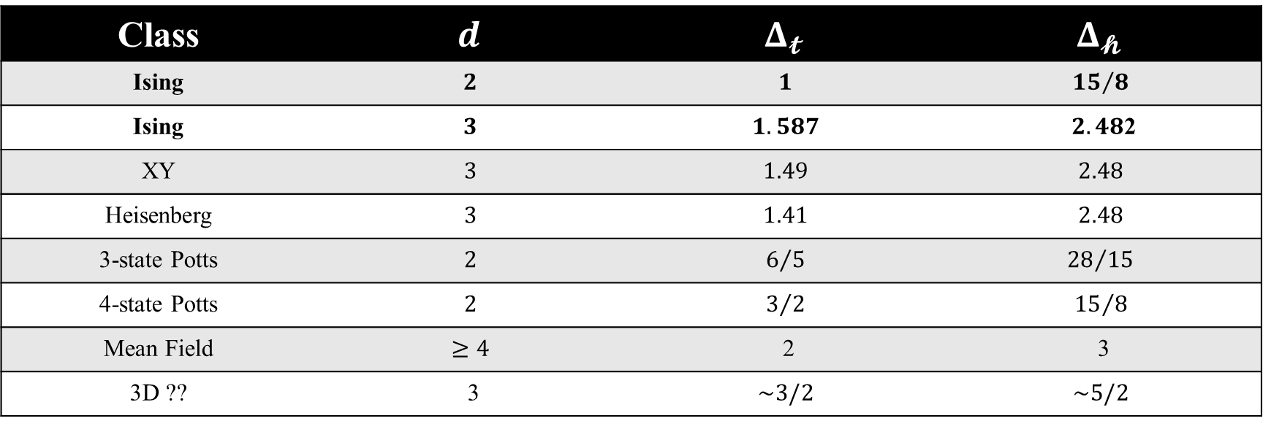
Scaling Dimensions
Class | $$d$$ | $$Δ_{𝓽}$$ | $$Δ_{𝓱}$$
Ising | $$2$$ | $$1$$ | $${15}/8$$
Ising | $$3$$ | $$1.587$$ | $2.48$2
XY | $$3$$ | $$1.49$$ | $$2.48$$
Heisenberg | $$3$$ | $$1.41$$ | $$2.48$$
3-state Potts | $$2$$ | $$6/5$$ | $${28}/{15}$$
4-state Potts | $$2$$ | $$3/2$$ | $${15}/8$$
Mean Field | $$≥4$$ | 2 | 3
3D ?? | 3 | $$\sim 3/2$$ | $$\sim 5/2$$

Slide 5
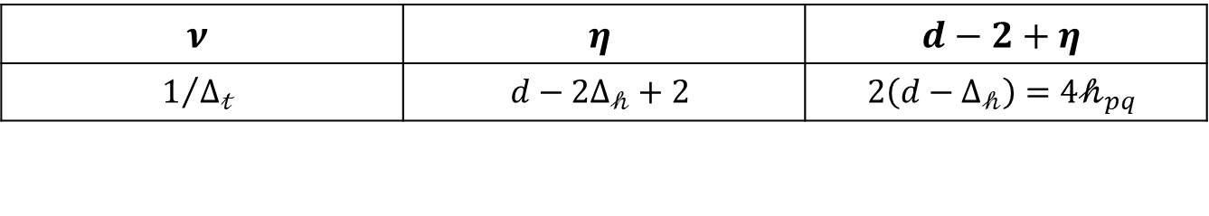
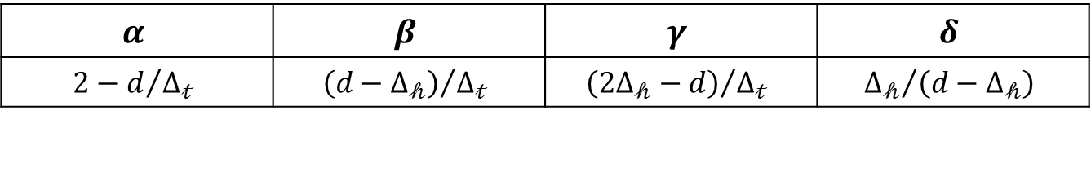
Scaling Laws
$$α$$ | $$β$$ | $$γ$$ | $$δ$$
$$2−d/{Δ_{𝓉}}$$ | $${\left(d−Δ_{𝒽}\right)}/{Δ_{𝓉}}$$ | $${\left(2Δ_{𝒽}−d\right)}/{Δ_{𝓉}}$$ | $${Δ_{𝒽}}/{\left(d−Δ_{𝒽}\right)}$$
$$ν$$ | $$η$$ | $$d−2+η$$
$$1/{Δ_{𝓉}}$$ | $$d−2Δ_{𝒽}+2$$ | $$2\left(d−Δ_{𝒽}\right)=4𝒽_{pq}$$

Slide 6
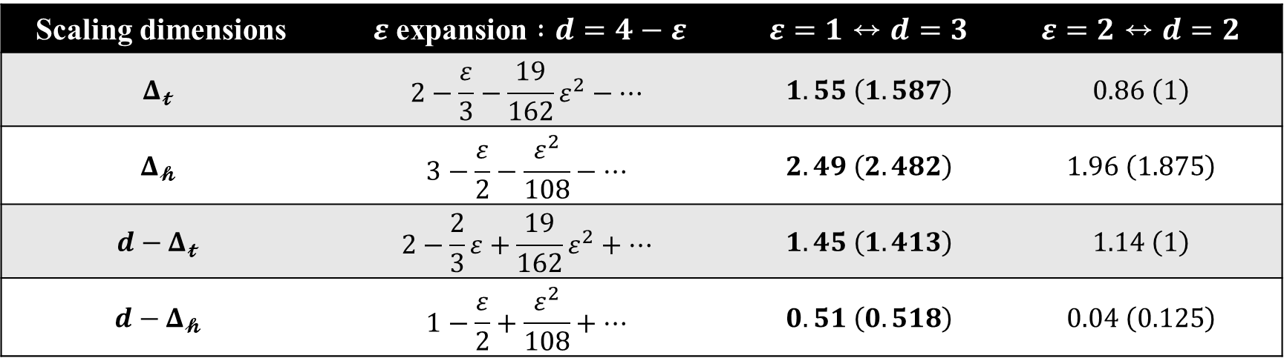

Epsilon expansion $:d=4−ε$
Scaling dimensions | $ε$ expansion $:d=4−ε$ | $$ε=1↔d=3$$ | $$ε=2↔d=2$$
$$Δ_{𝓽}$$ | $$2−\frac{ε}{3}−\frac{19}{162}ε^{2}−⋯$$ | $$1.55 \left(1.587\right)$$ | $$0.86 \left(1\right)$$
$$Δ_{𝓱}$$ | $$3−\frac{ε}{2}−\frac{ε^{2}}{108}−…$$ | $$2.49 \left(2.482\right)$$ | $$1.96 \left(1.875\right)$$
$$d−Δ_{𝓽}$$ | $$2−\frac{2}{3}ε+\frac{19}{162}ε^{2}+⋯$$ | $$1.45 \left(1.413\right)$$ | $$1.14 \left(1\right)$$
$$d−Δ_{𝓱}$$ | $$1−\frac{ε}{2}+\frac{ε^{2}}{108}+⋯$$ | $$0.51 \left(0.518\right)$$ | $$0.04 \left(0.125\right)$$

Slide 7
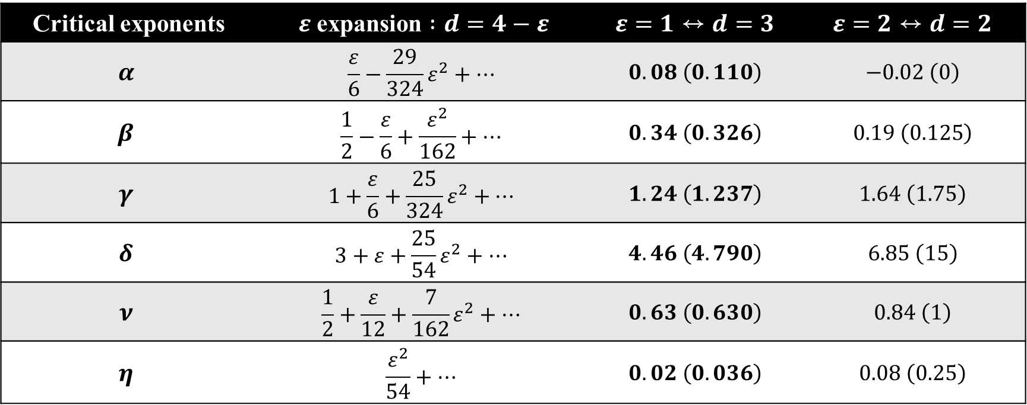
Epsilon expansion $:d=4−ε$
Critical exponents | $ε$ expansion $:d=4−ε$ | $$ε=1↔d=3$$ | $$ε=2↔d=2$$
$$α$$ | $$\frac{ε}{6}−\frac{29}{324}ε^{2}+⋯$$ | $$0.08 \left(0.110\right)$$ | $$−0.02 \left(0\right)$$
$$β$$ | $$\frac{1}{2}−\frac{ε}{6}+\frac{ε^{2}}{162}+⋯$$ | $$0.34 \left(0.326\right)$$ | $$0.19 \left(0.125\right)$$
$$γ$$ | $$1+\frac{ε}{6}+\frac{25}{324}ε^{2}+⋯$$ | $$1.24 \left(1.237\right)$$ | $$1.64 \left(1.75\right)$$
$$δ$$ | $$3+ε+\frac{25}{54}ε^{2}+⋯$$ | $$4.46 \left(4.790\right)$$ | $$6.85 \left(15\right)$$
$$ν$$ | $$\frac{1}{2}+\frac{ε}{12}+\frac{7}{162}ε^{2}+⋯$$ | $$0.63 \left(0.630\right)$$ | $$0.84 \left(1\right)$$
$$η$$ | $$\frac{ε^{2}}{54}+⋯$$ | $$0.02 \left(0.036\right)$$ | $$0.08 \left(0.25\right)$$

Slide 8
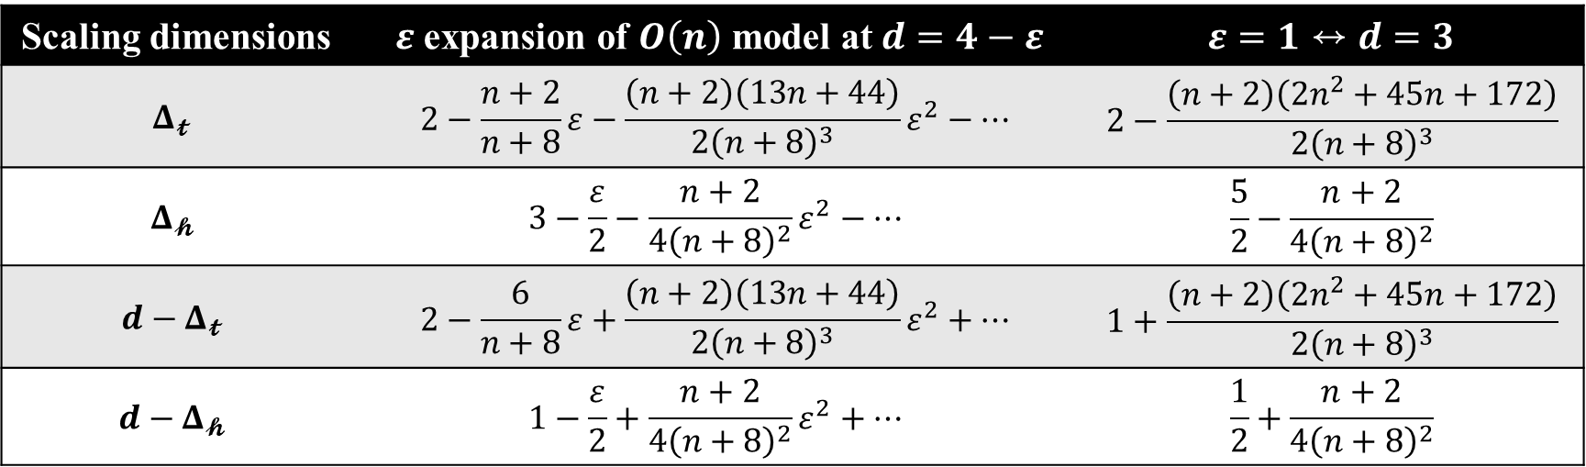

Epsilon expansion of $O\left(N\right)$ model
Scaling dimensions | $ε$ expansion of $O\left(n\right)$ model at$d=4−ε$ | $$ε=1↔d=3$$
$$Δ_{𝓽}$$ | $$2−\frac{n+2}{n+8}ε−\frac{\left(n+2\right)\left(13n+44\right)}{2{\left(n+8\right)}^{3}}ε^{2}−⋯$$ | $$2−\frac{\left(n+2\right)\left(2n^{2}+45n+172\right)}{2{\left(n+8\right)}^{3}}$$
$$Δ_{𝓱}$$ | $$3−\frac{ε}{2}−\frac{n+2}{4{\left(n+8\right)}^{2}}ε^{2}−…$$ | $$\frac{5}{2}−\frac{n+2}{4{\left(n+8\right)}^{2}}$$
$$d−Δ_{𝓽}$$ | $$2−\frac{6}{n+8}ε+\frac{\left(n+2\right)\left(13n+44\right)}{2{\left(n+8\right)}^{3}}ε^{2}+⋯$$ | $$1+\frac{\left(n+2\right)\left(2n^{2}+45n+172\right)}{2{\left(n+8\right)}^{3}}$$
$$d−Δ_{𝓱}$$ | $$1−\frac{ε}{2}+\frac{n+2}{4{\left(n+8\right)}^{2}}ε^{2}+⋯$$ | $$\frac{1}{2}+\frac{n+2}{4{\left(n+8\right)}^{2}}$$

Slide 9
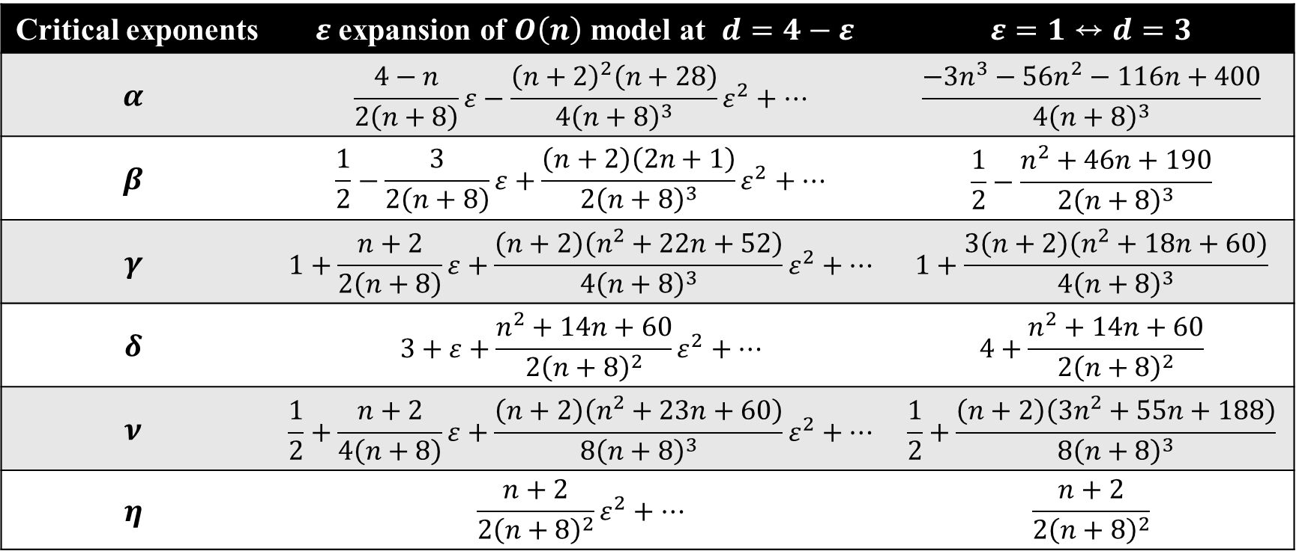
Epsilon expansion of $O\left(N\right)$ model
Critical exponents | $ε$ expansion of $O\left(n\right)$ model at $d=4−ε$ | $$ε=1↔d=3$$
$$α$$ | $$\frac{4−n}{2\left(n+8\right)}ε−\frac{{\left(n+2\right)}^{2}\left(n+28\right)}{4{\left(n+8\right)}^{3}}ε^{2}+⋯$$ | $$\frac{−3n^{3}−56n^{2}−116n+400}{4{\left(n+8\right)}^{3}}$$
$$β$$ | $$\frac{1}{2}−\frac{3}{2\left(n+8\right)}ε+\frac{\left(n+2\right)\left(2n+1\right)}{2{\left(n+8\right)}^{3}}ε^{2}+⋯$$ | $$\frac{1}{2}−\frac{n^{2}+46n+190}{2{\left(n+8\right)}^{3}}$$
$$γ$$ | $$1+\frac{n+2}{2\left(n+8\right)}ε+\frac{\left(n+2\right)\left(n^{2}+22n+52\right)}{4{\left(n+8\right)}^{3}}ε^{2}+⋯$$ | $$1+\frac{3\left(n+2\right)\left(n^{2}+18n+60\right)}{4{\left(n+8\right)}^{3}}$$
$$δ$$ | $$3+ε+\frac{n^{2}+14n+60}{2{\left(n+8\right)}^{2}}ε^{2}+⋯$$ | $$4+\frac{n^{2}+14n+60}{2{\left(n+8\right)}^{2}}$$
$$ν$$ | $$\frac{1}{2}+\frac{n+2}{4\left(n+8\right)}ε+\frac{\left(n+2\right)\left(n^{2}+23n+60\right)}{8{\left(n+8\right)}^{3}}ε^{2}+⋯$$ | $$\frac{1}{2}+\frac{\left(n+2\right)\left(3n^{2}+55n+188\right)}{8{\left(n+8\right)}^{3}}$$
$$η$$ | $$\frac{n+2}{2{\left(n+8\right)}^{2}}ε^{2}+⋯$$ | $$\frac{n+2}{2{\left(n+8\right)}^{2}}$$

Slide 10
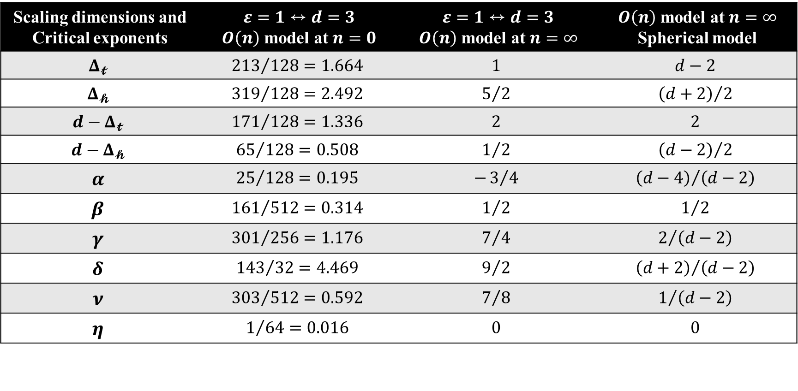

$O\left(n=0, ∞\right)$ model at $d=3$
Scaling dimensions and Critical exponents | $$ε=1↔d=3$$ $O\left(n\right)$ model at $n=0$ | $$ε=1↔d=3$$ $O\left(n\right)$ model at $n=∞$ | $O\left(n\right)$ model at $n=∞$ Spherical model
$$Δ_{𝓽}$$ | $${213}/{128}=1.664$$ | $$1$$ | $$d−2$$
$$Δ_{𝓱}$$ | $${319}/{128}=2.492$$ | $$5/2$$ | $${\left(d+2\right)}/2$$
$$d−Δ_{𝓽}$$ | $${171}/{128}=1.336$$ | $$2$$ | $$2$$
$$d−Δ_{𝓱}$$ | $${65}/{128}=0.508$$ | $$1/2$$ | $${\left(d−2\right)}/2$$
$$α$$ | $${25}/{128}=0.195$$ | $$−3/4$$ | $${\left(d−4\right)}/{\left(d−2\right)}$$
$$β$$ | $${161}/{512}=0.314$$ | $$1/2$$ | $$1/2$$
$$γ$$ | $${301}/{256}=1.176$$ | $$7/4$$ | $$2/{\left(d−2\right)}$$
$$δ$$ | $${143}/{32}=4.469$$ | $$9/2$$ | $${\left(d+2\right)}/{\left(d−2\right)}$$
$$ν$$ | $${303}/{512}=0.592$$ | $$7/8$$ | $$1/{\left(d−2\right)}$$
$$η$$ | $$1/{64}=0.016$$ | $$0$$ | $$0$$

Slide 11
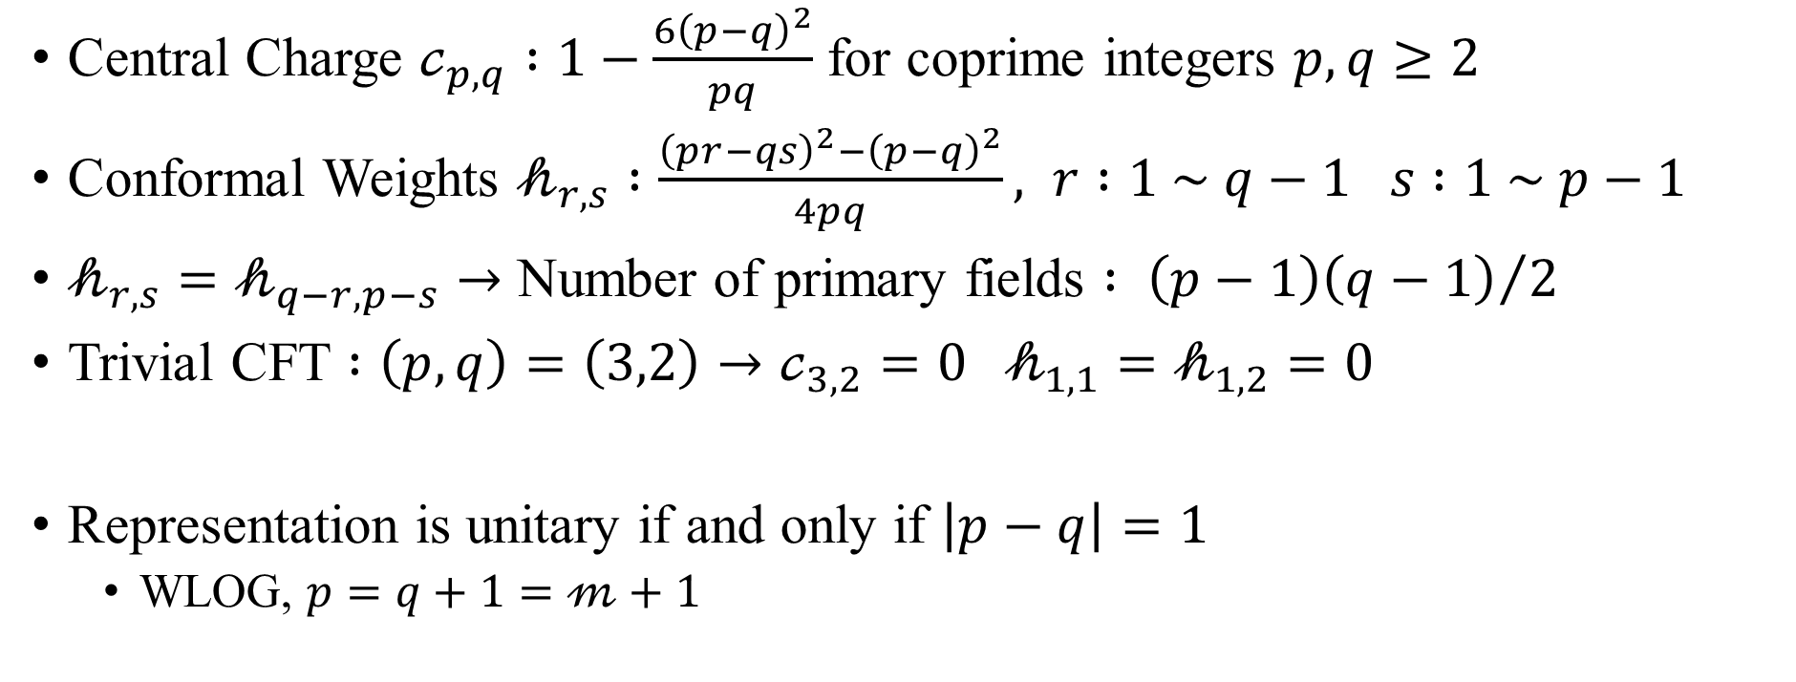
Representation of Virasoro Algebra
Central Charge $𝒸_{p,q} :1−\frac{6{\left(p−q\right)}^{2}}{pq}$ for coprime integers $p,q≥2$
Conformal Weights $𝒽_{r,s} :\frac{{\left(pr−qs\right)}^{2}−{\left(p−q\right)}^{2}}{4pq}, r :1 \sim q−1 s :1 \sim p−1$
$𝒽_{r,s}=𝒽_{q−r,p−s}→$ Number of primary fields $: {\left(p−1\right)\left(q−1\right)}/2$
Trivial CFT $:\left(p,q\right)=\left(3,2\right)→𝒸_{3,2}=0 𝒽_{1,1}=𝒽_{1,2}=0$
Representation is unitary if and only if $\left|p−q\right|=1$
WLOG, $p=q+1=𝓂+1$

Slide 12
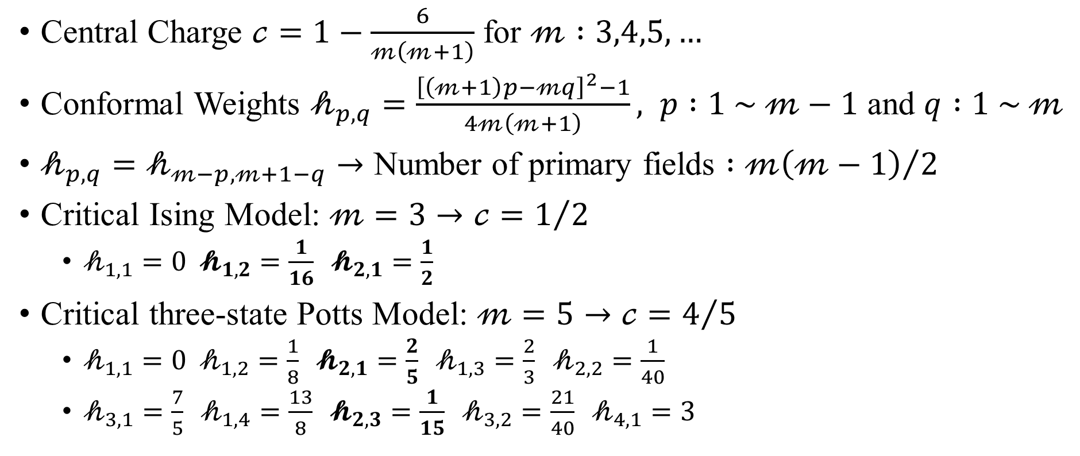
Unitary Representation of Virasoro Algebra
Central Charge $𝒸=1−\frac{6}{𝓂\left(𝓂+1\right)}$ for $𝓂 :3,4,5,…$
Conformal Weights $𝒽_{p,q}=\frac{{\left[\left(𝓂+1\right)p−𝓂q\right]}^{2}−1}{4𝓂\left(𝓂+1\right)}, p :1 \sim 𝓂−1$ and $q :1 \sim 𝓂$
$𝒽_{p,q}=𝒽_{𝓂−p,𝓂+1−q}→$ Number of primary fields $:{𝓂\left(𝓂−1\right)}/2$
Critical Ising Model: $𝓂=3→𝒸=1/2$
$𝒽_{1,1}=0 𝓱_{1,2}=\frac{1}{16} 𝓱_{2,1}=\frac{1}{2}$
Critical three-state Potts Model: $𝓂=5→𝒸=4/5$
$𝒽_{1,1}=0 𝒽_{1,2}=\frac{1}{8} 𝓱_{2,1}=\frac{2}{5} 𝒽_{1,3}=\frac{2}{3} 𝒽_{2,2}=\frac{1}{40}$
$𝒽_{3,1}=\frac{7}{5} 𝒽_{1,4}=\frac{13}{8} 𝓱_{2,3}=\frac{1}{15} 𝒽_{3,2}=\frac{21}{40} 𝒽_{4,1}=3$

Slide 13
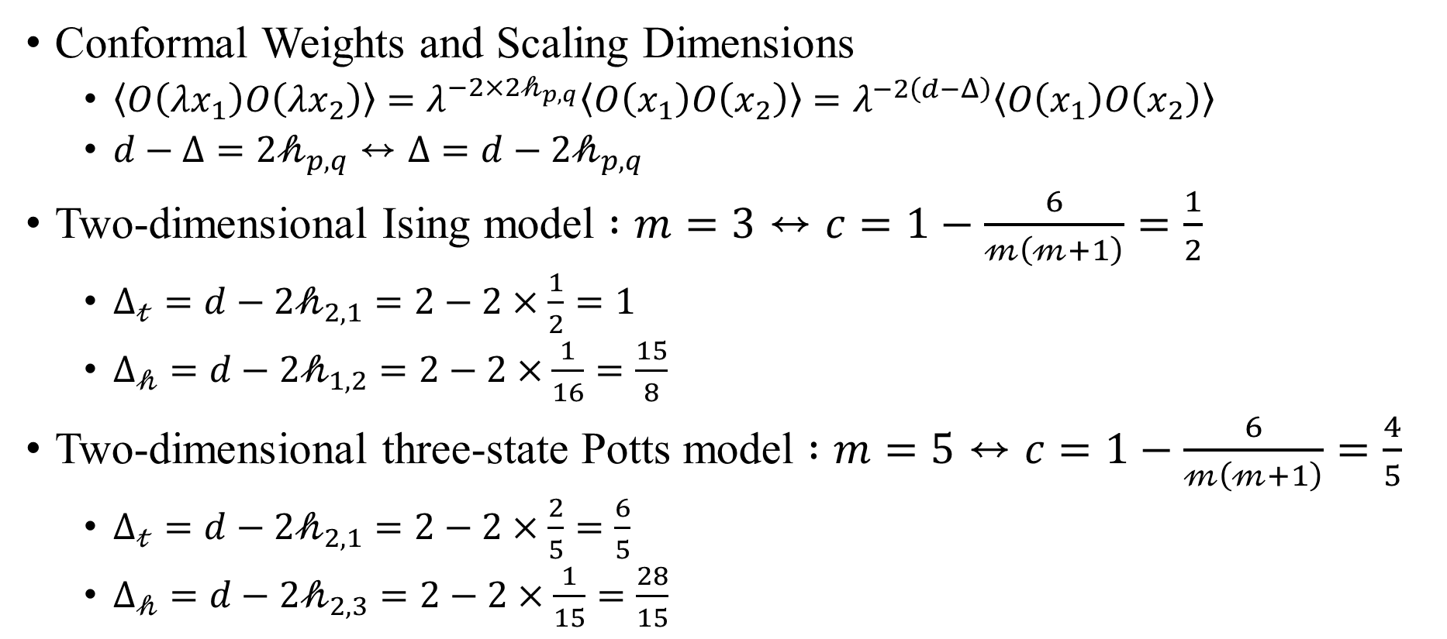
Conformal Field Theory
Conformal Weights and Scaling Dimensions
$\left\langle O\left(λx_{1}\right)O\left(λx_{2}\right)\right\rangle =λ^{−2×2𝒽_{p,q}}\left\langle O\left(x_{1}\right)O\left(x_{2}\right)\right\rangle =λ^{−2\left(d−Δ\right)}\left\langle O\left(x_{1}\right)O\left(x_{2}\right)\right\rangle$
$d−Δ=2𝒽_{p,q}↔Δ=d−2𝒽_{p,q}$
Two-dimensional Ising model $:m=3↔c=1−\frac{6}{𝓂\left(𝓂+1\right)}=\frac{1}{2}$
$Δ_{𝓉}=d−2𝒽_{2,1}=2−2×\frac{1}{2}=1$
$Δ_{𝒽}=d−2𝒽_{1,2}=2−2×\frac{1}{16}=\frac{15}{8}$
Two-dimensional three-state Potts model $:m=5↔c=1−\frac{6}{𝓂\left(𝓂+1\right)}=\frac{4}{5}$
$Δ_{𝓉}=d−2𝒽_{2,1}=2−2×\frac{2}{5}=\frac{6}{5}$
$Δ_{𝒽}=d−2𝒽_{2,3}=2−2×\frac{1}{15}=\frac{28}{15}$

Slide 14
Conformal Bootstrap

